Slide 1
GST BILLING SOFTWARE
Prepared by
Rishabh Jaishwal
Mohit Kumar
Shivam Kumar
Nipun Kumar

Slide 2
Introduction
GST Billing Software is based on new Indian Tax System for creating Invoice easily with basic knowledge.
It have simple UI in comparison to Tally ERP 9. Tally ERP 9 require training before use because of it’s complex UI.
Our Software Provide different Panel access for employee and admin.
Statistics can be easily taken by admin for the Invoices created by different Employee.
By using Java Print API , We can also Print the Invoice for Customer.

Slide 3
Software Used
Java JDK version 1.7 or above
MySql database
Jtatoo Jar for UI Design
Java Mysql Database Connector Jar

Slide 4
Hardware Used For Development
I3 processor (1.7 GHZ 4th generation)
4 GB RAM
2 GB Graphic card

Slide 5
UI Design
Jtatoo library for UI Design Look and Feel
Package used For UI Design “com.jtattoo.plaf.mcwin.McWinLookAndFeel”
Layout MDI Application

Slide 6
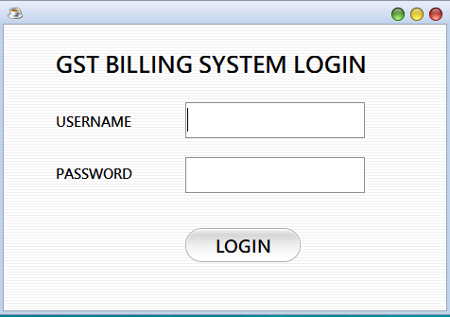
Demo Pages for GST Billing Software
Single Login Field for Logged Into Software As Employee Or Admin.
Use of Two Roles Give Different Permission To access the Software.

Slide 7
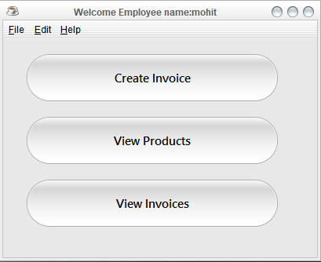
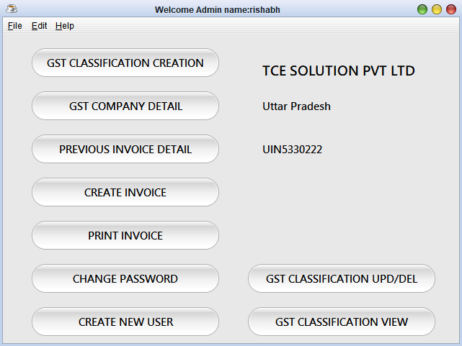
After Login MDI Application Starts
Employee Panel
Admin Panel

Slide 8
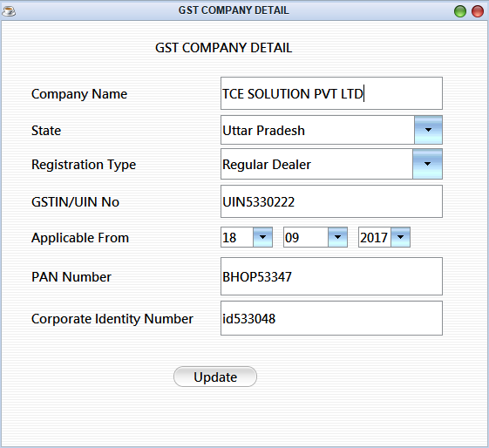
JInternal Frame for Changing Company Details

Slide 9
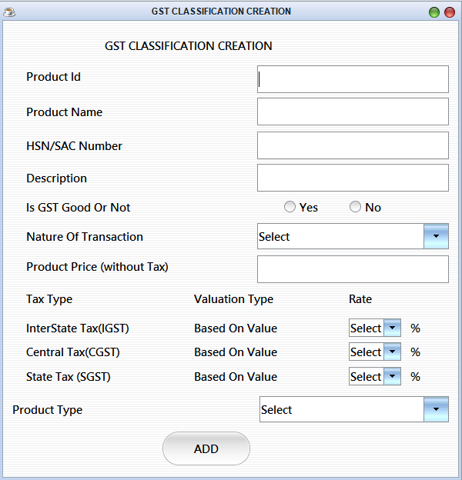
JInternal Frame for Creating GST Products

Slide 10
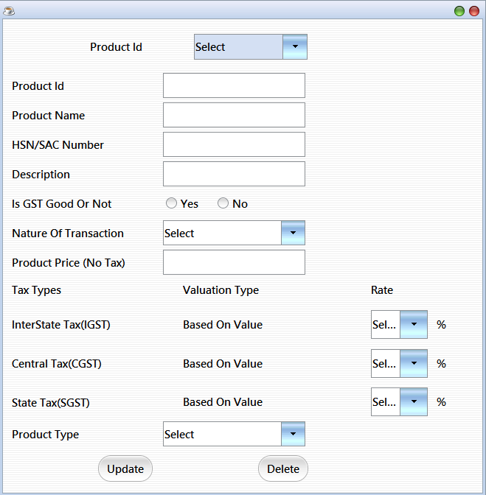
Update/Delete GST Product Classification

Slide 11
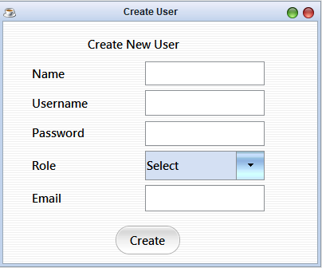
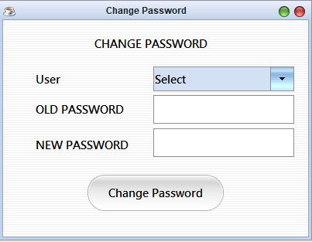
Creating New Login/Changing Password from Admin Panel

Slide 12
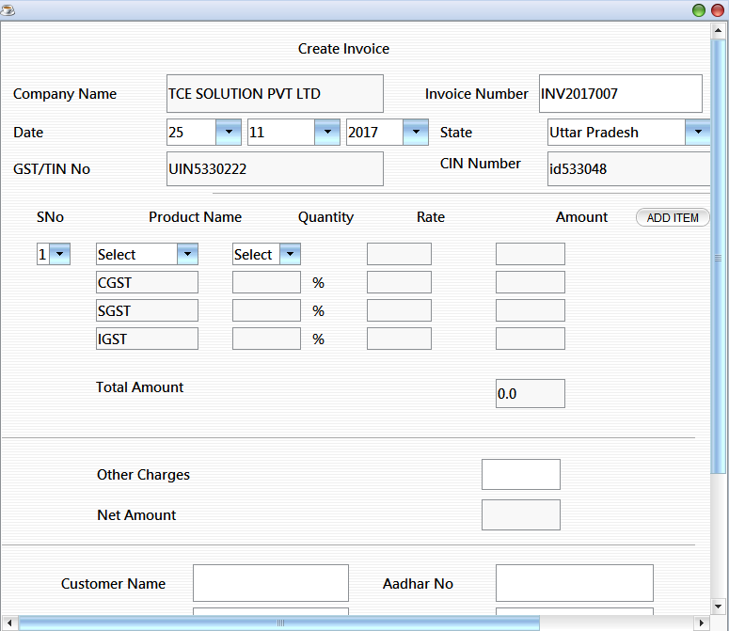
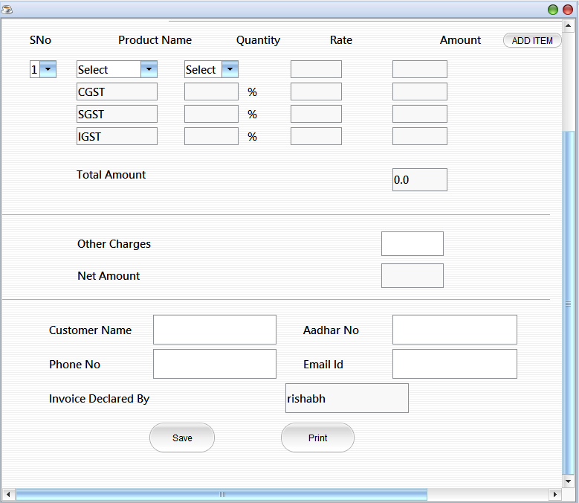
Create And Print Invoice

Slide 13
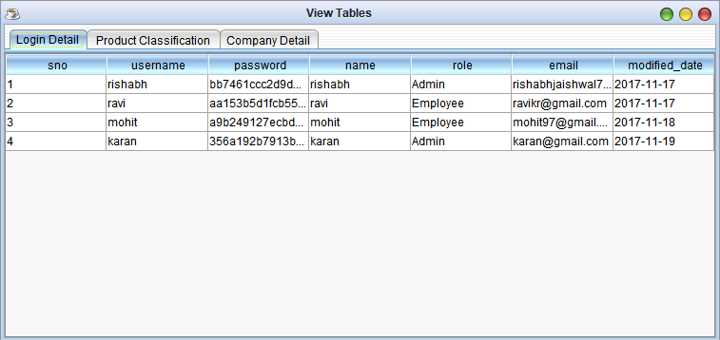
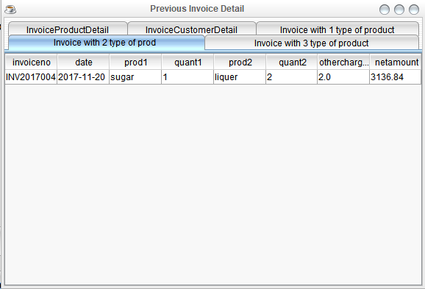
Tables for Statistics

Slide 14
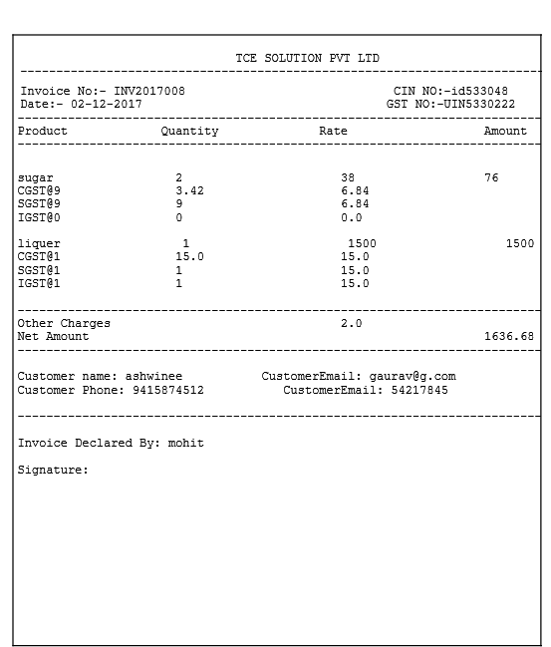
Printed Invoice

Slide 15
Thank You

